Slide 1
Weather Tools

Slide 2
What are tools?
Can you think of a tool that is used to measure weather?

Slide 3
Congratulations! You are an employee of a company named “Weather Or Not?”. Your company manufactures meteorological instruments.
You are up for a job promotion and have your choice of one of the following jobs:

Slide 4
manufacturer (responsible for manufacturing a visual of your tool and explaining what your instrument measures and/or used for)
graphic designer (2 people responsible for organizing/typing information on a powerpoint in addition to explaining how your weather instrument works). This powerpoint will be shared with your class.
sales representative (responsible for presenting materials and 3 facts/history about your instrument.)

Slide 5
Student instructions
We will count off from numbers 1-9 in order to form 9 small research groups.
Your group will be responsible for collecting and presenting information to the class about a weather instrument and its uses.
Your group will be given 2 sheets of copy paper, 2 planning sheets, and weather tools graphic organizers for everyone.
You have 30 minutes to draw a full sized colored picture on a piece of copy paper and fill out all the information on the planning sheet. Once time is up we will start student presentations

Slide 6
Rain Gauge
A tool used to measure the amount of precipitation over a period of time
How it’s used:
A large cylinder with funnel inside collects accumulated precipitation that is measured with a ruler to the nearest one hundredth

Slide 7
Thermometer
A tool used to measure temperature
Importance:
Tells how hot/cold something is in degrees Fahrenheit or Celsius

Slide 8
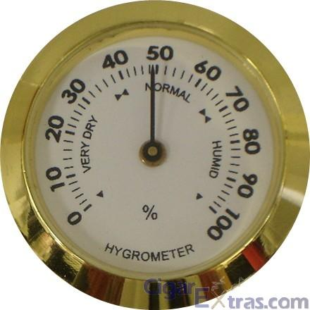
Hygrometer
A tool used to measure humidity
Importance:
Tells information about moisture in air which helps predict rain or snow, and tells how damp or dry air is

Slide 9
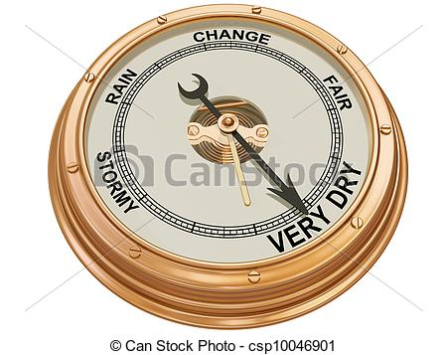
Barometer
A tool used to measure air pressure
Importance:
Measures changes in atmosphere
Rapid drop in pressure means low pressure systems
What type of weather is associated with low pressure systems?

Slide 10
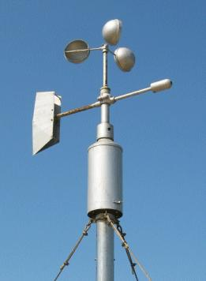
Anemometer
A tool used to measure the wind speed
How it’s used:
Consists of 3 metal cups attached to a rod that rotates as the wind blows

Slide 11
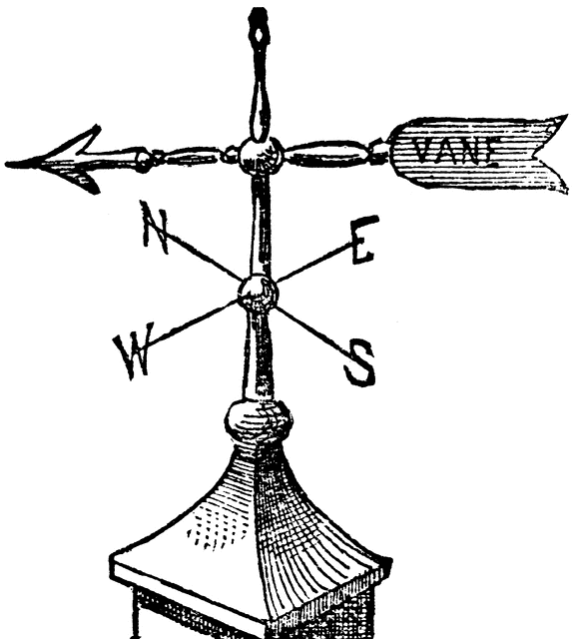
Wind Vane
A tool used to measure the DIRECTION of the wind
Importance:
The arrow points in the direction from which the wind is blowing

Slide 12
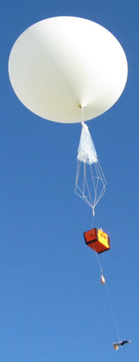
Weather Balloon
A tool used to collect high altitude forecast data
Importance:
Records temperature, humidity, and air pressure high into the atmosphere informing us on potential/future storms
https://www.youtube.com/watch?v=EABQ5psUz70

Slide 13
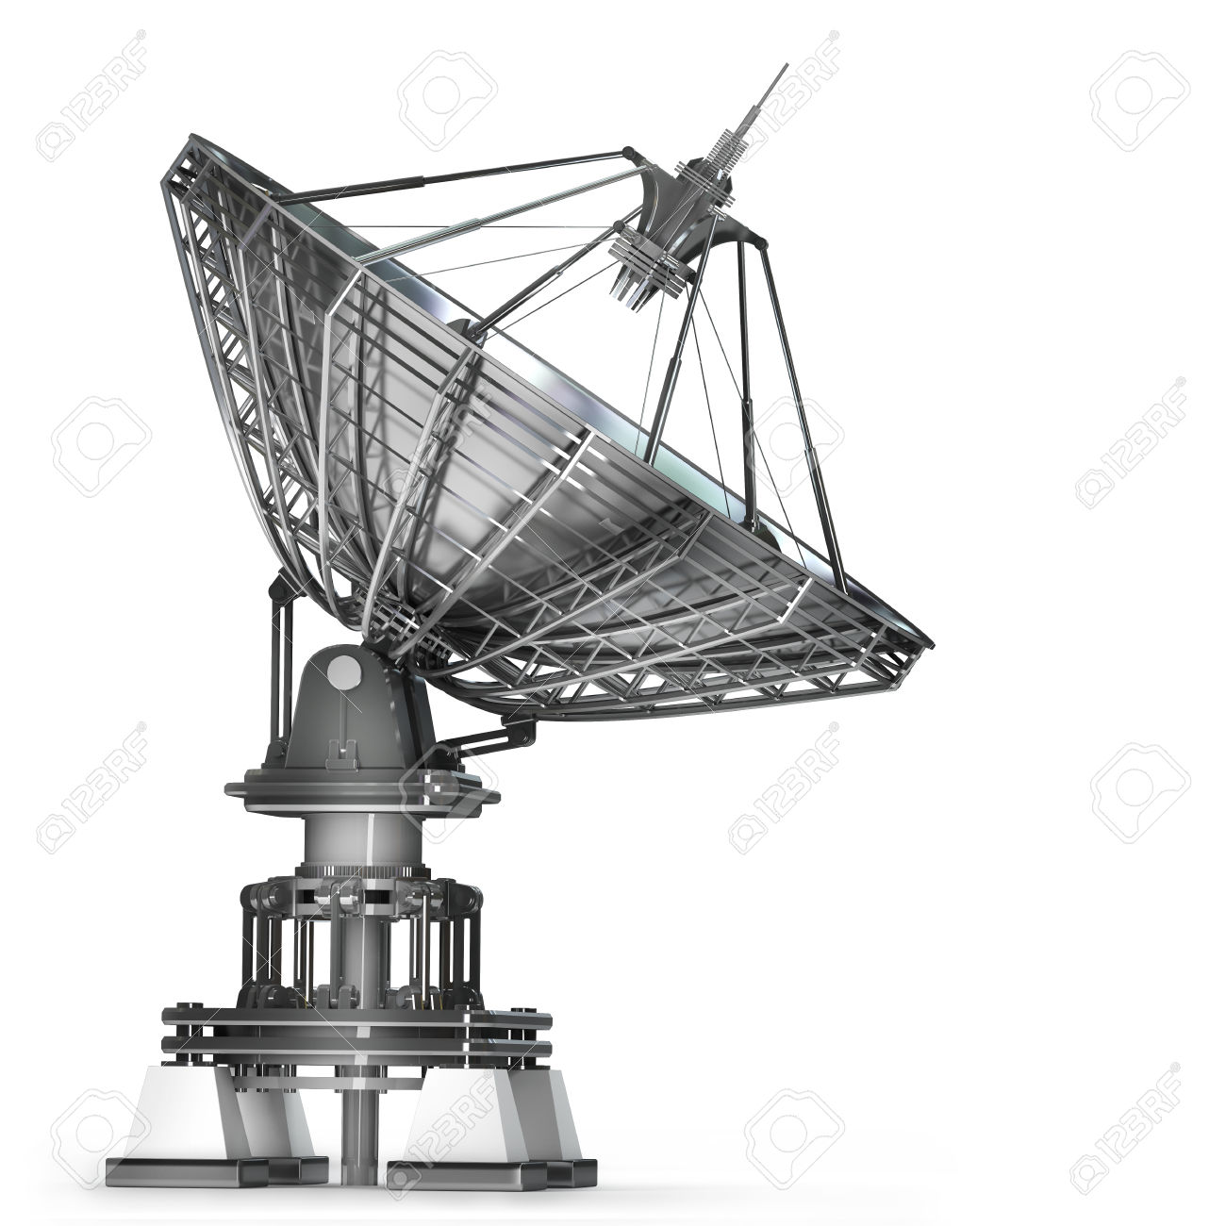
Doppler Radar
A tool used to monitor the movement of precipitation
How it’s used:
Radio waves are emitted in a given direction and are reflected off an object, telling how far away it is. Great for tracking storms locations
https://www.youtube.com/watch?v=sHIb8j9B0Ok

Slide 14
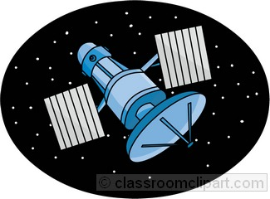
Weather Satellite
A tool used to monitor weather and climate on Earth
How it’s used:
A scanning mechanism transmits data and images from outer space that shows clouds, ocean currents, and storm movement
https://www.youtube.com/watch?v=K2irBOjGUHc
https://www.youtube.com/watch?v=zfVeB4s8WWk

Slide 15
Exit Tix
Bailey Middle School students love going to outdoor PA, but meteorologists reported a potential heavy downpour midday today. Which device would Mr. Thomas best rely on in order to determine whether or not students can have outdoor PA around noon.
Anemometer
Weather balloon
Weather Satellite
Rain gauge
Abby wants to measure the amount of moisture in the air. She does not want the water in the air to mess up her hair. What instrument should she use?
Barometer
Anemometer
Hygrometer
Thermometer

Slide 16
Helpful Sites for students
https://climate.ncsu.edu/edu/k12/.instruments
http://usatoday30.usatoday.com/weather/wmeasur0.htm
http://science.howstuffworks.com/nature/climate-weather/meteorological-instruments

